Slide 1
ANCESTRY
“WIKI”
(NOT!!!)

Slide 2
Wiki is a piece of server software that allows users to freely create and edit Web page content using any Web browser. Wiki supports hyperlinks and has a simple text syntax for creating new pages and crosslinks between internal pages on the fly.
What is Wiki?

Slide 4
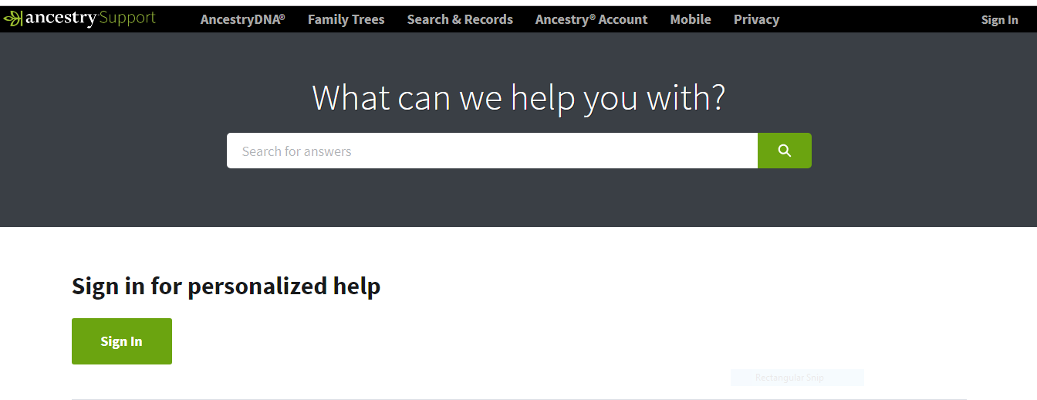

Slide 5
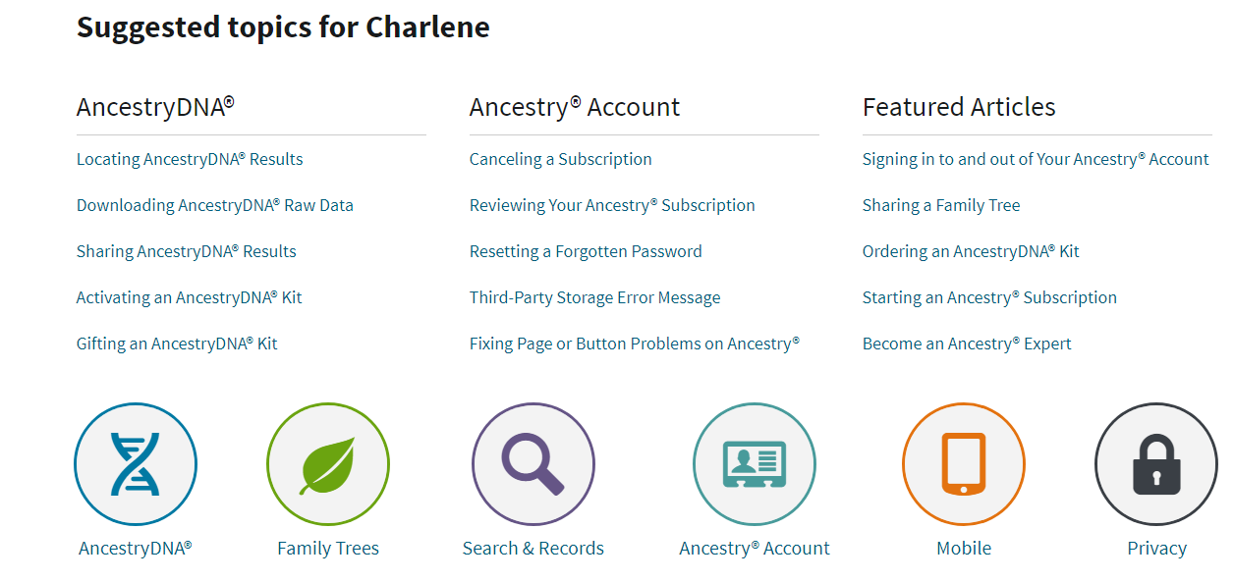

Slide 7
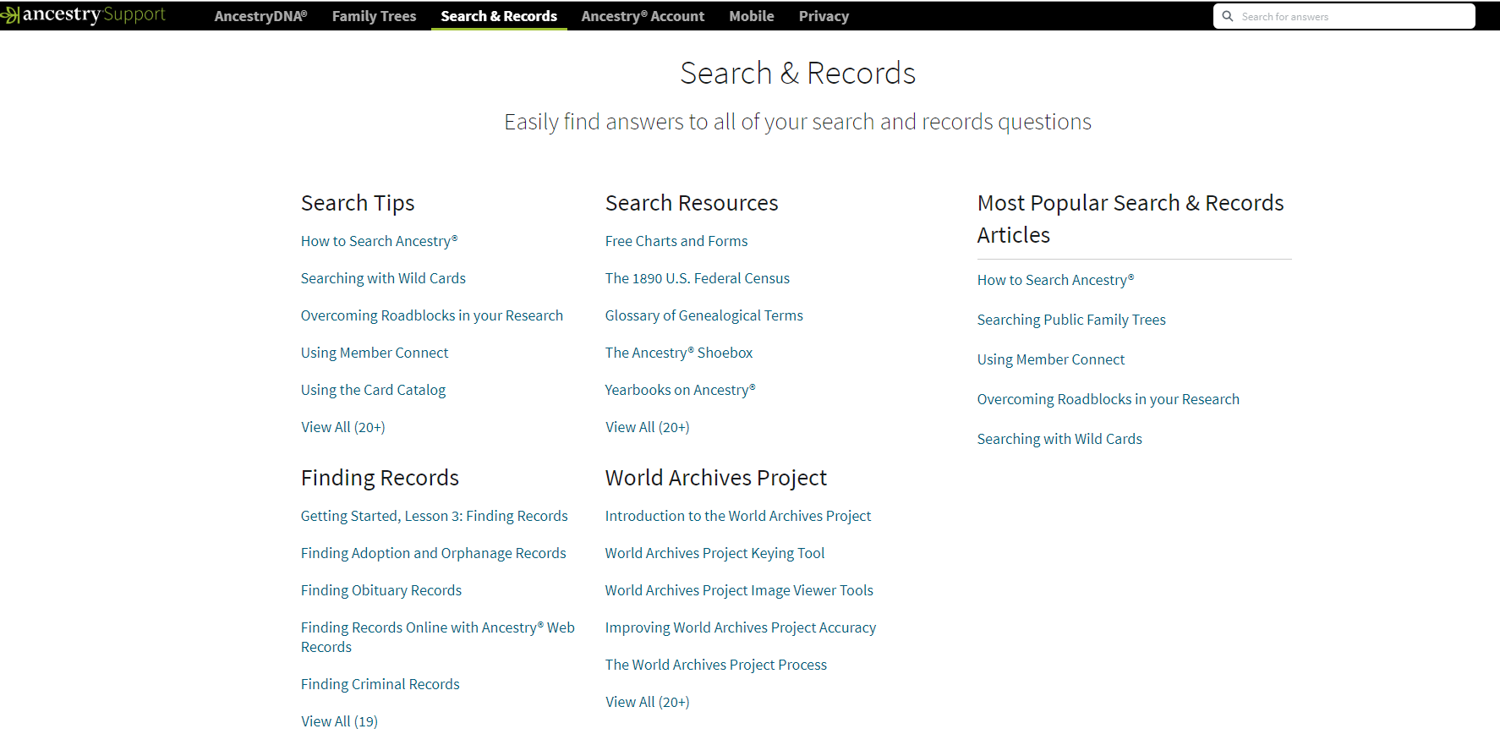

Slide 8
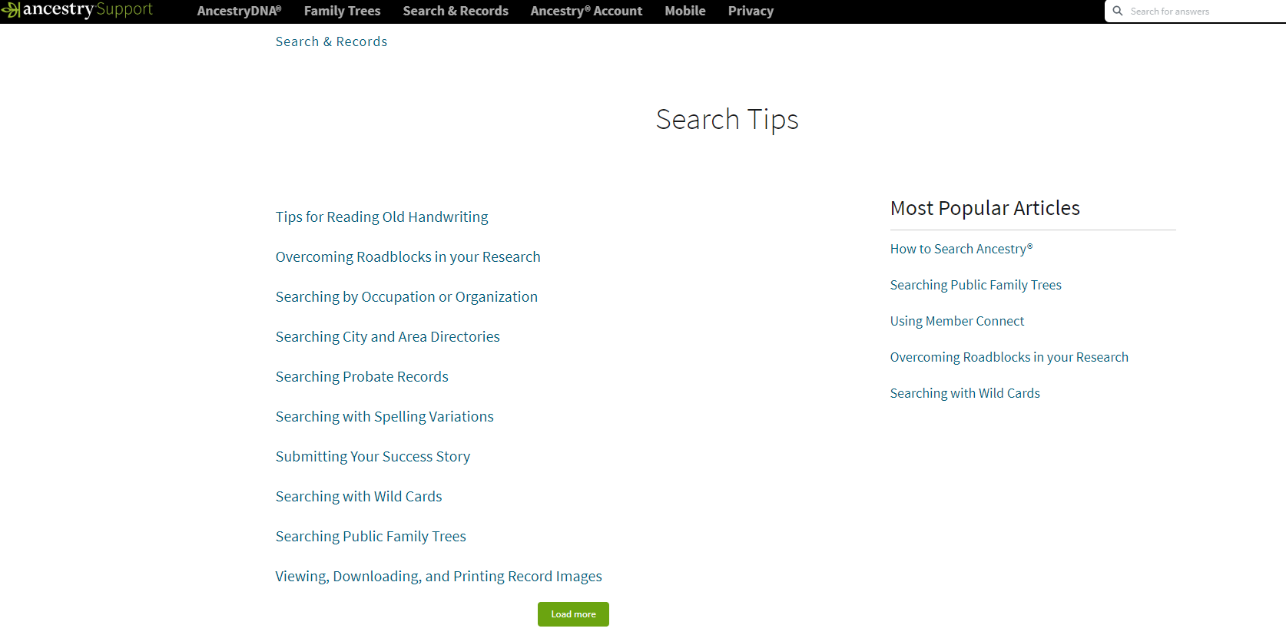

Slide 9
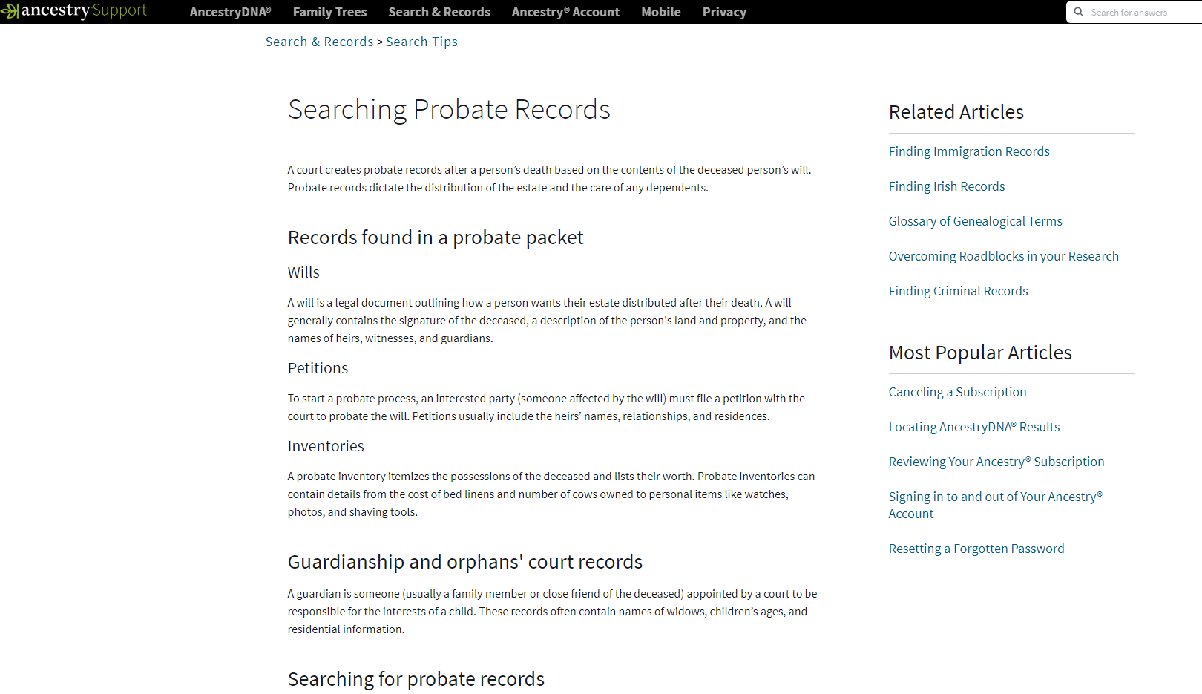

Slide 11
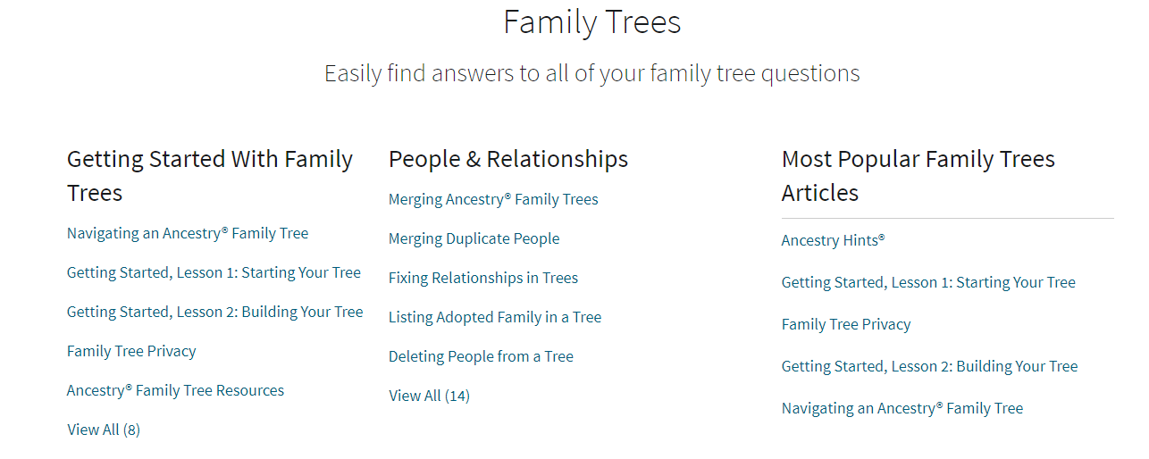

Slide 12
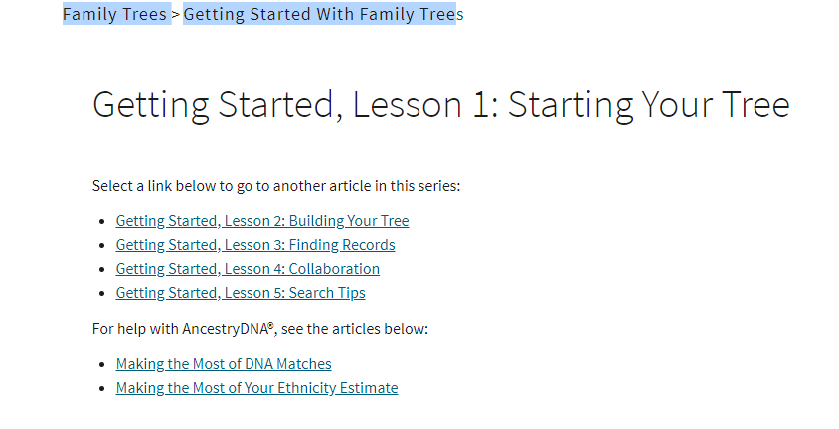

Slide 13
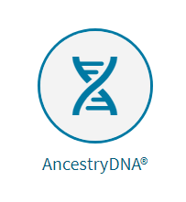

Slide 14
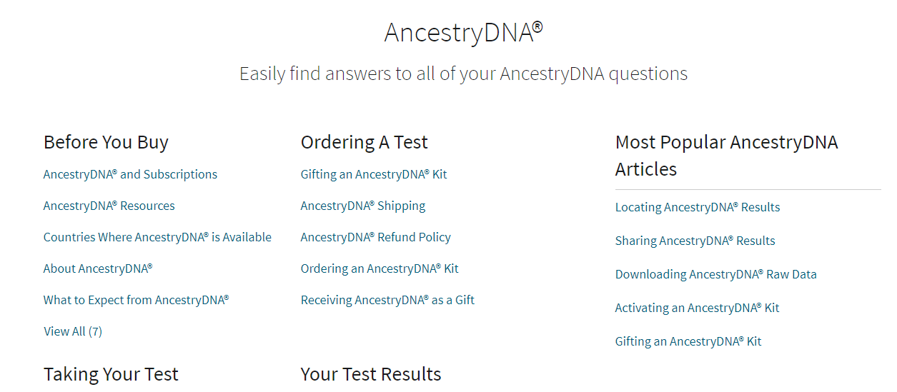

Slide 15
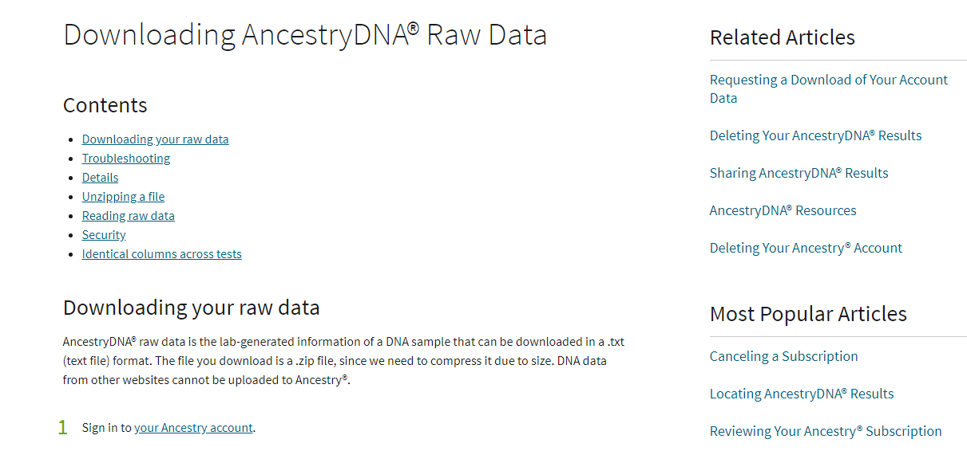

Slide 16
The End

