Slide 1
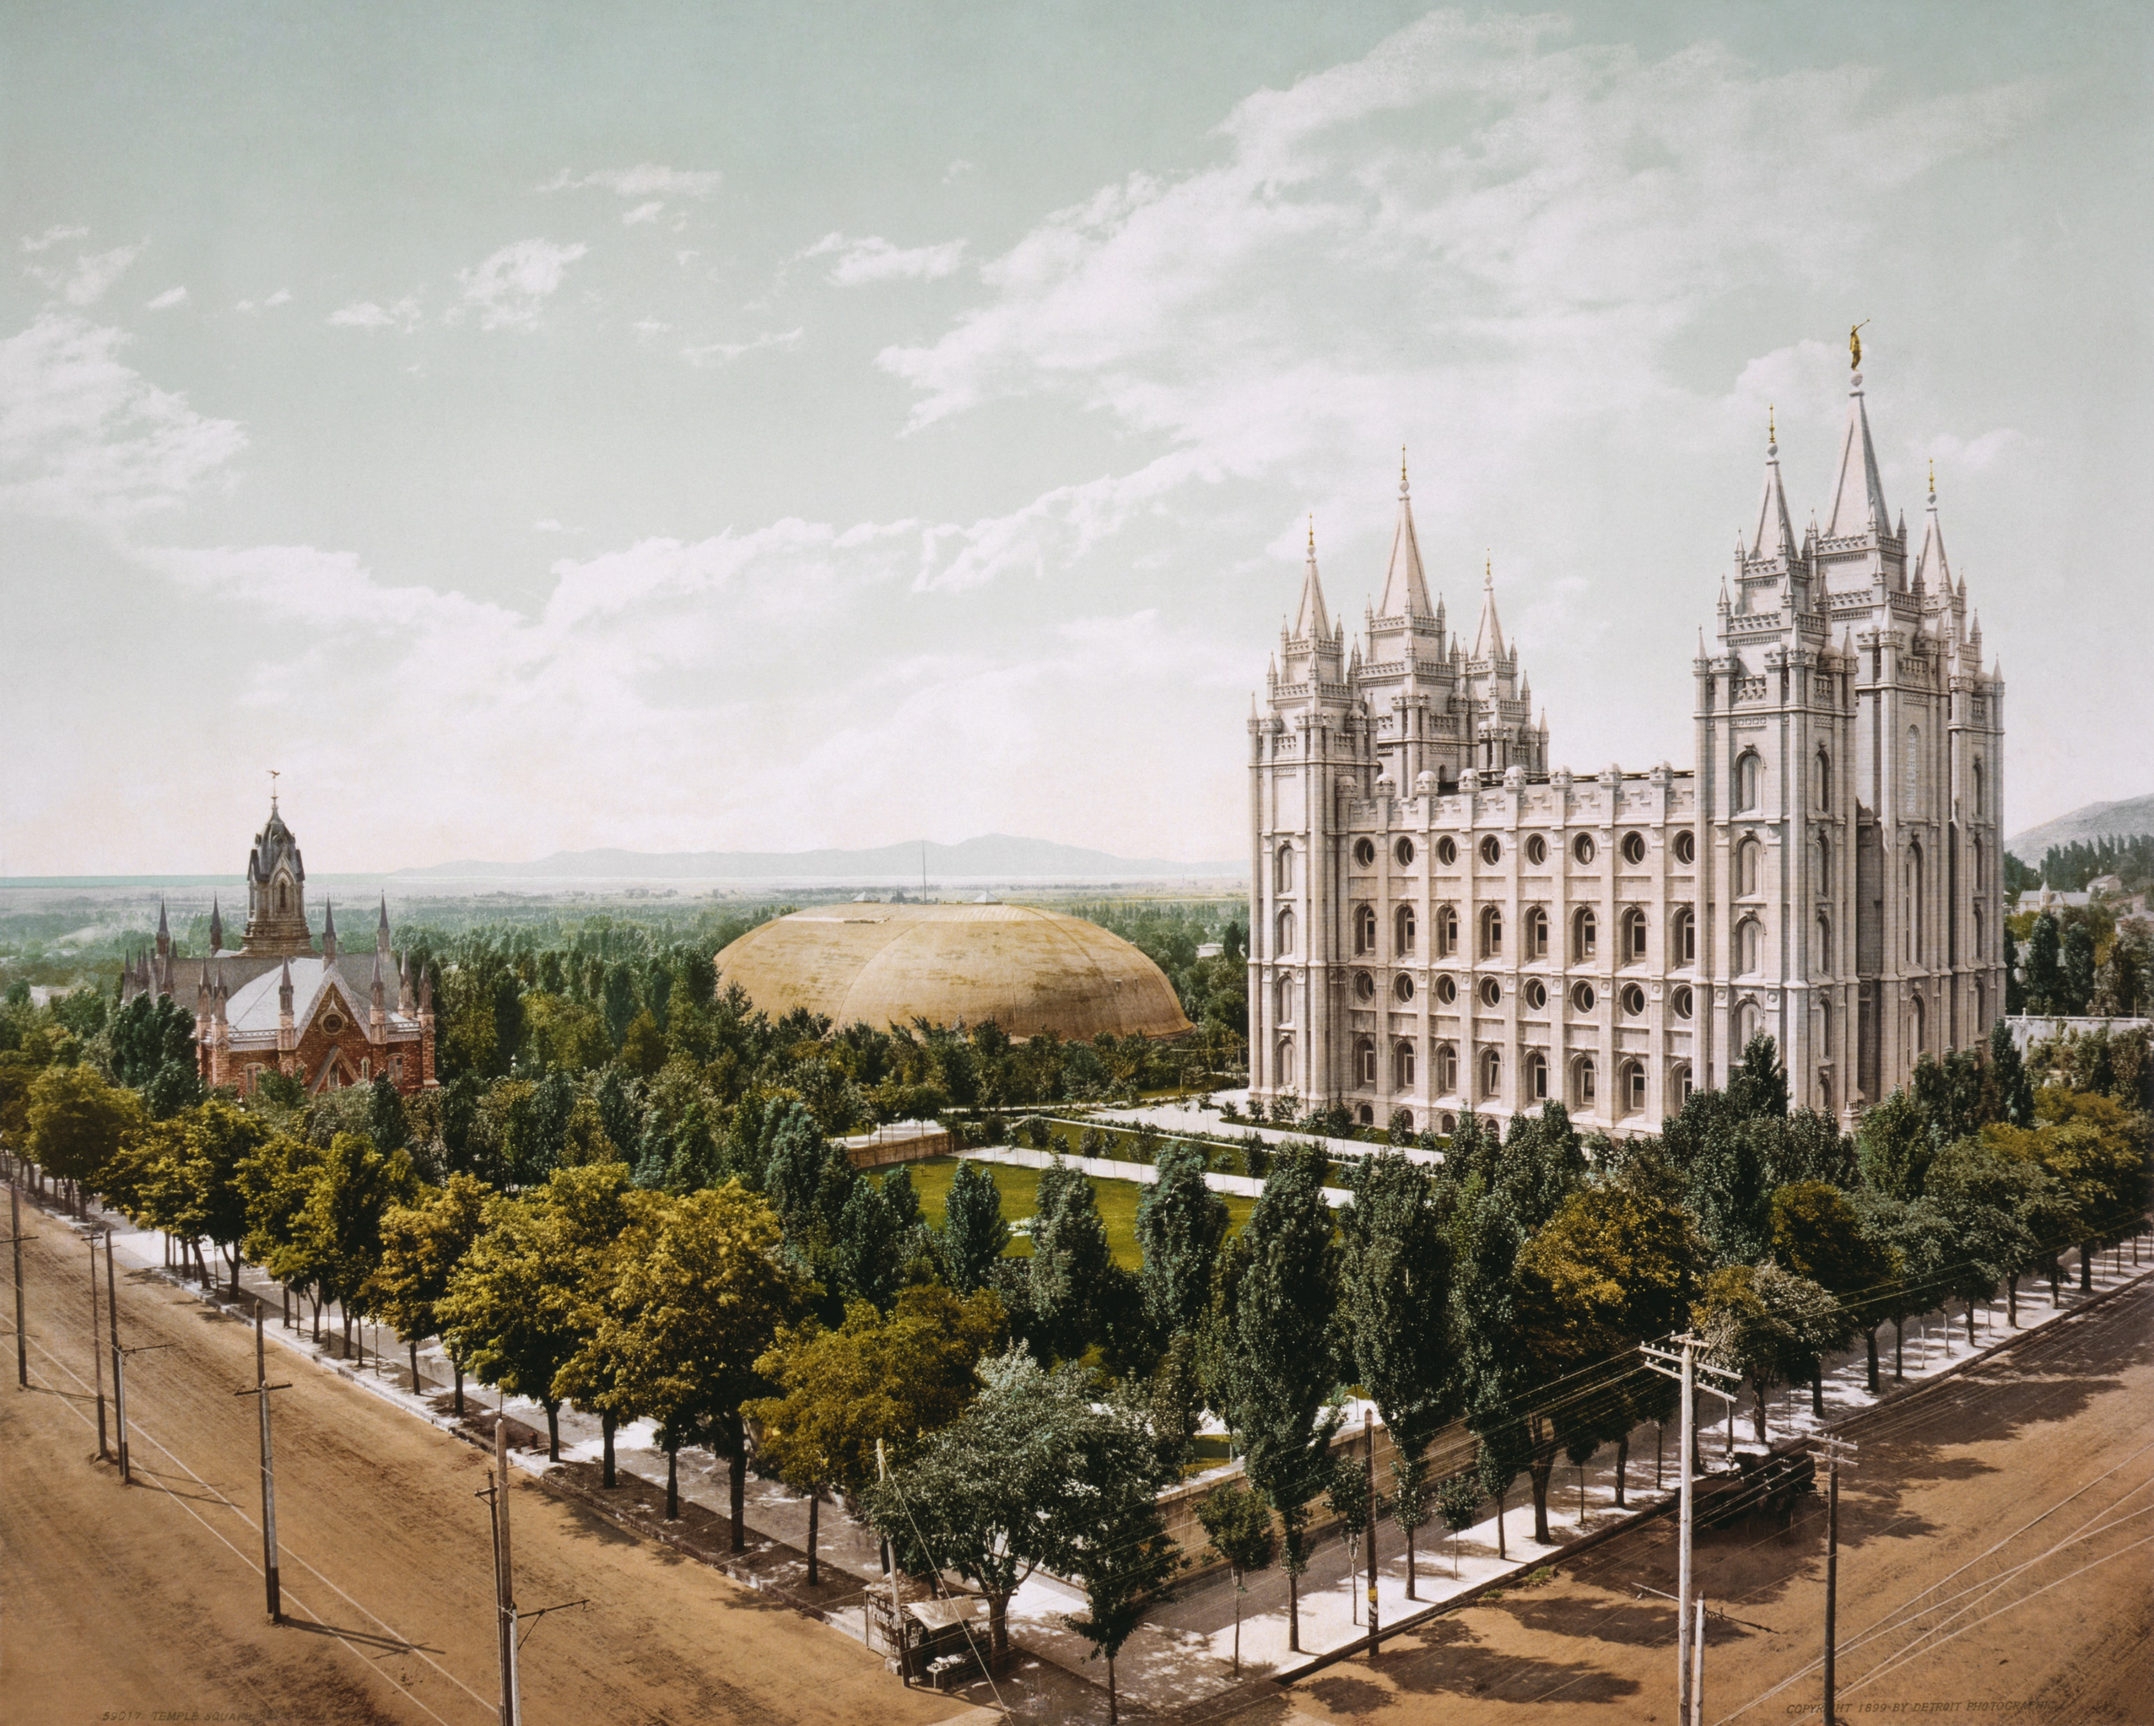
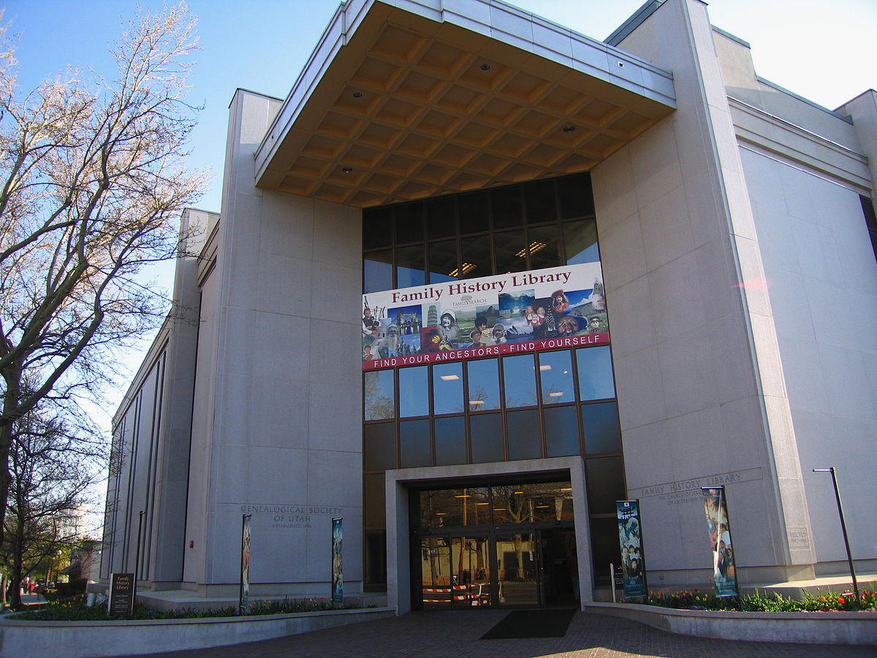
The Church of Jesus Christ of Latter-day Saints
Family History Library
Salt Lake City, Utah
GSGC – October 2021

Slide 2
WHY VISIT A FAMILY HISTORY CENTER?

Slide 3
FREE ACCESS TO PREMIUM RESOURCES
Fold3 – military records and stories ($$)
Newspaper.com – online newspaper archives - 12,000 newpapers spanning 1700’s to 2000’s ($$)
Ancestry Institution Version – access level equivalent to World subscription ($$)
MyHeritage Library Edition – additional research
FindMyPast – focused on UK Ancestry. Not full content. ($$)
American Ancestors – created by the New England Historic Genealogical Society. Largely New England focused. ($$)

Slide 4
PREMIUM RESOURCES
ArkivDigital – largest private provider of Swedish church records. ($$)
FamNet – research New Zealand roots
Geneanet – dedicated to genealogy in France, Belgium, the Netherlands, Sweden and Germany. ($$)
PaperTrail – 19th century westward American migration documents
Alexander Street ($$)
The American Civil War – Research database
The American Civil War – Letters and Diaries
The American Civil War – Images, Photographs, Posters and Ephemera

Slide 5
RESTRICTED RECORDS (aka LOCKED/LIMITED ACCESS records)
Some collections have contractual agreements limiting locations authorized to access records.
FHC internet addresses are specifically identified for access to restricted collections
Affiliate libraries (eg. Chapin Memorial Library) may not be extended the same access

Slide 6
September 21, 2021 - Digitization of Microfilm Completed Ahead of Schedule
Started in 1998
Estimated to take 50 years to complete (technology advances cut the time by 30 years.)
Last “roll” was captured in 2018
New images of original records will be directly captured digitally
Total of 2.4 MILLION rolls are now digitized
11.5 BILLION records/individuals
The next major project will address digitizing 335,000 microfiche in the collections

Slide 7
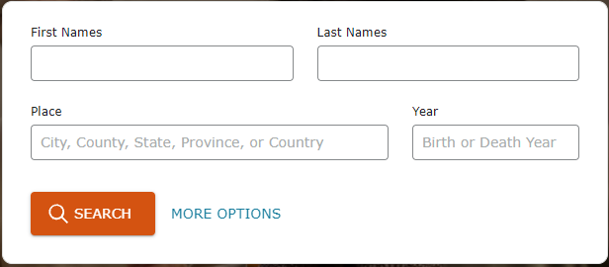
Recent Updates/Changes:
New Search Screen

Slide 8
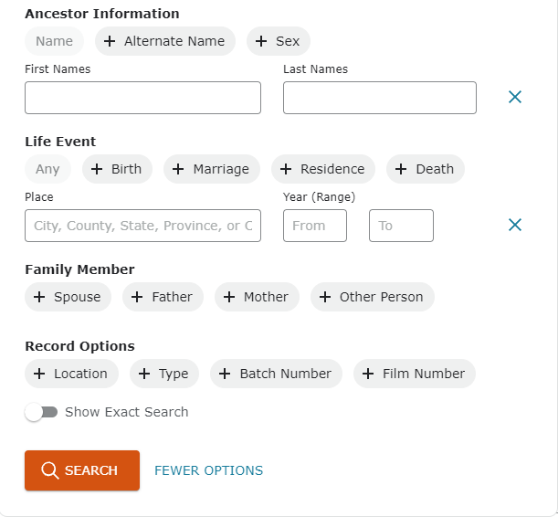
More Options:

Slide 9
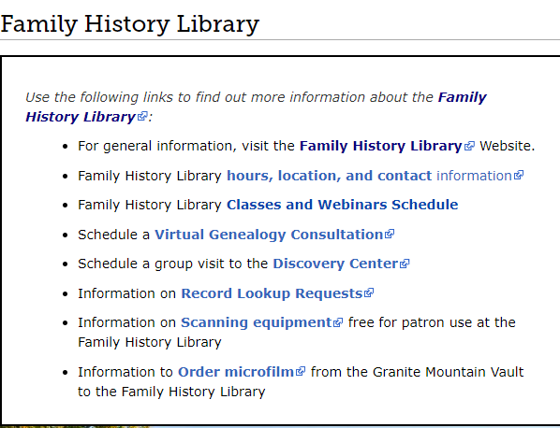
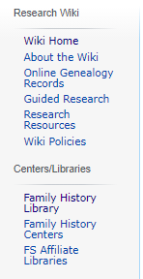
Family Search Wiki

Slide 10
FAMILY HISTORY CENTER
ByPass 17 and 48th Ave North
Myrtle Beach, SC
Current Schedule:
Second and fourth Wednesday of each month
6-8 pm
Resources:
3 computers available for research
Bring removable drive (thumb drive) for saving images
B&W printer is available for hard copy images
Staffing:
Volunteer(s)
Lynn Samuelson, FHC Director (lynnsamuelson02@sccoast.net)
Charlene Carson (cc.buffalo.gal@verizon.net)

Slide 11
THAT’S ALL FOLKS!!!

