Slide 1
DNA Roundtable
August 13, 2022

Slide 2
DNA | Male | Female | Comments
Autosomal DNA Chromosomes 1 - 22 | Can Receive from any Ancestor | Can Receive from any Ancestor | You may NOT actually receive DNA from every distant ancestor in amounts large enough for matching today. However, that is because of the random nature of recombination
X DNA | Receives an X only from his mother | Receives an X from both mother and father | Males give their daughter their mother’s X Chromosome in its entirety
Y DNA | Receive from father | Never Receive | The Y Chromosome confers the male gender. Y DNA is found on the Y Chromosome and is a stretch of DNA that males share with males in the paternal line
mtDNA | Receive from mother’s direct line | Receive from mother’s direct line | Men do not pass their mtDNA on to offspring

Slide 3
DNA | Ancestry 20 mil + | 23andMe 12 mil + | My Heritage 5 mil + | Family Tree 1.4 mil +
Autosomal DNA Chromosomes 1 – 22 | Pros: Largest Data Base, Family Tree Support tools for matching Con: Chromosome Browser | Pro: Chromosome Browser and Compare and Share Raw data download DNA Painter Con: Family Tree Support Tools | Pro: Intuitive Navigation DNA Cluster Con: Limited data base | Pro: Variety of scientifically based research tools Con: Limited data base.
X DNA | Not Available | Males and females | Not Available | Available with multiple tools
Y DNA | Not Available | High level Haplogroup | Not Available | Available with multiple tools
mtDNA | Not Available | Haplogroup | Not Available | Specific Haplogroup with multiple tools

Slide 4
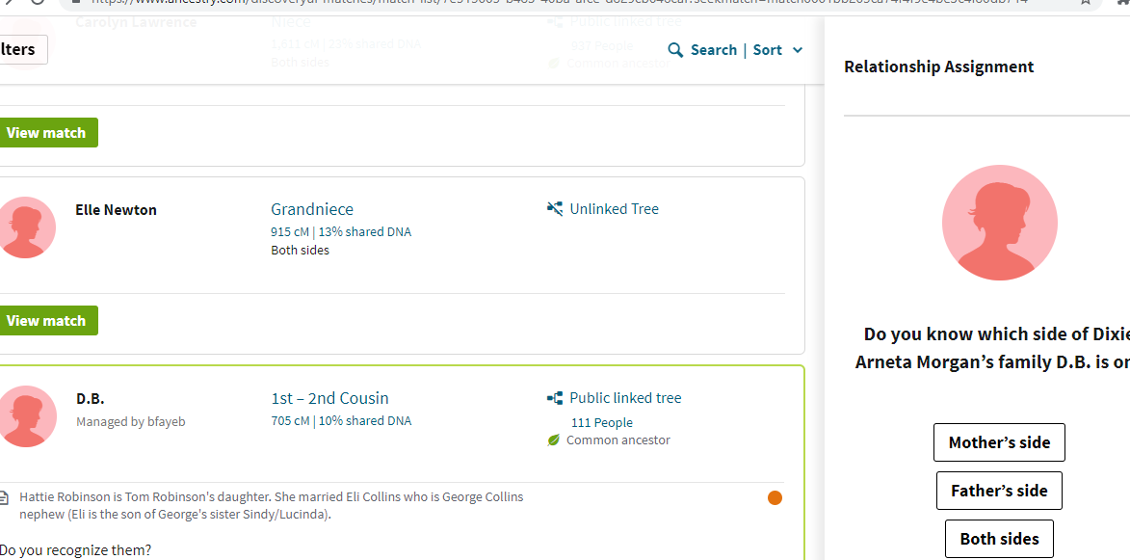

Slide 5
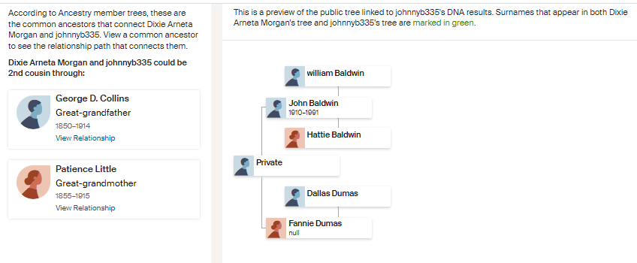

Slide 6
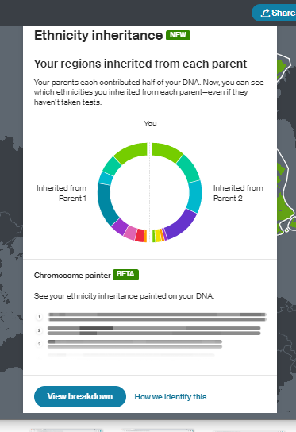

Slide 7
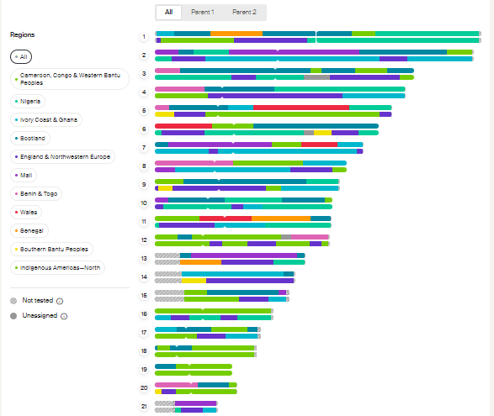

Slide 8
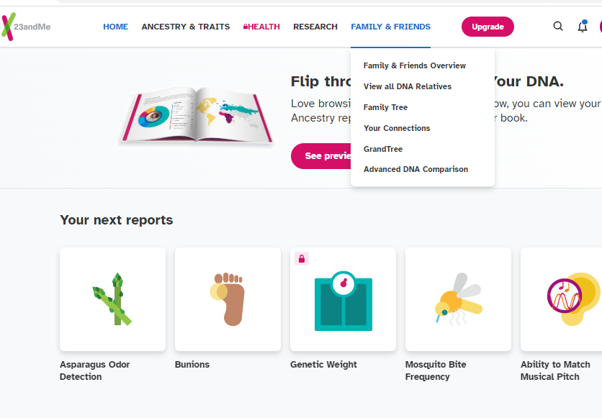

Slide 9
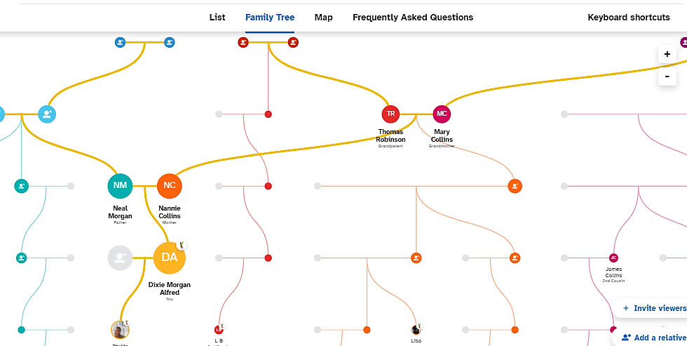

Slide 10
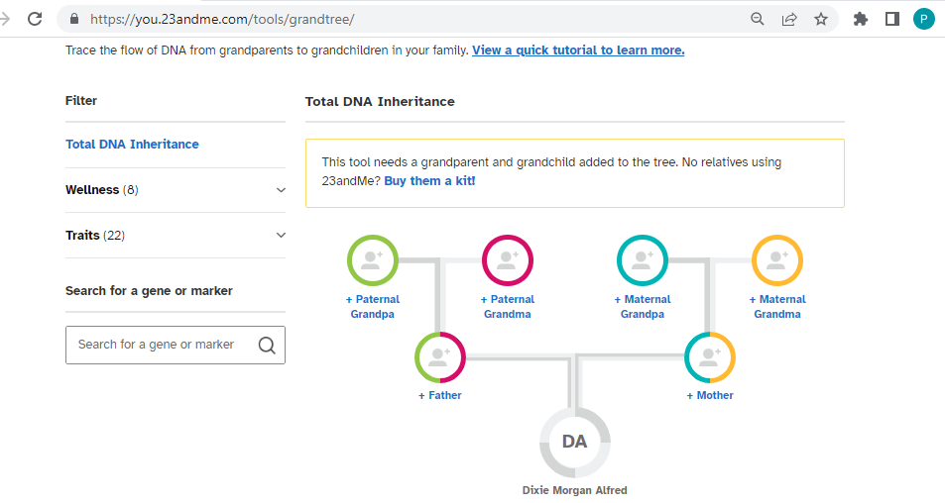

Slide 11
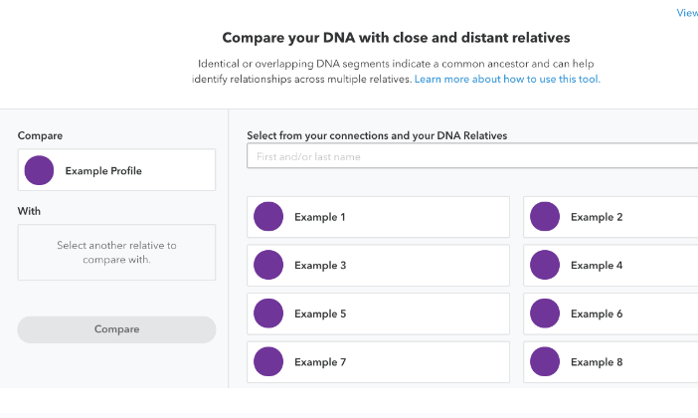

Slide 12
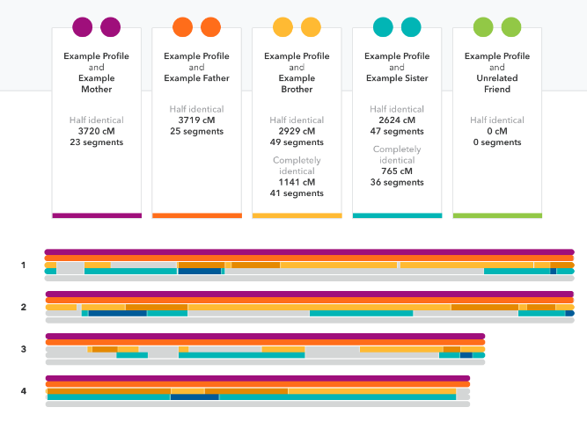

Slide 13
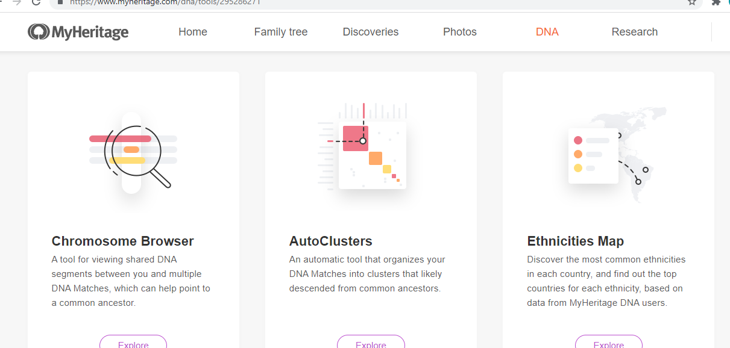

Slide 14
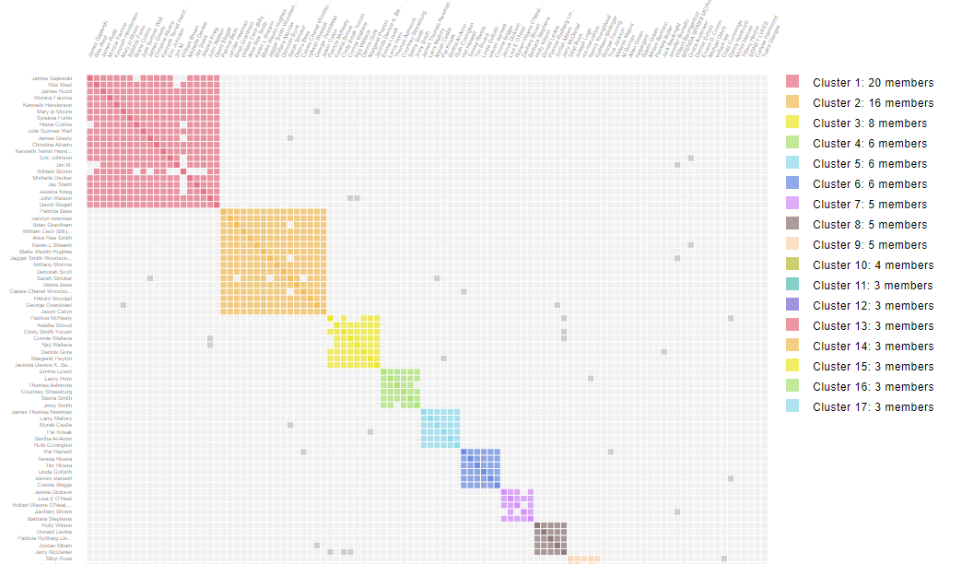

Slide 15
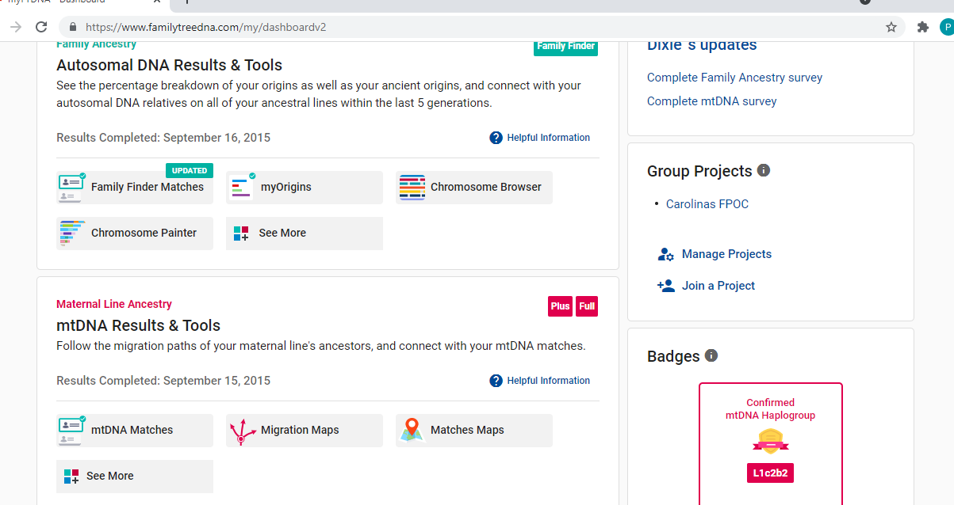

Slide 16
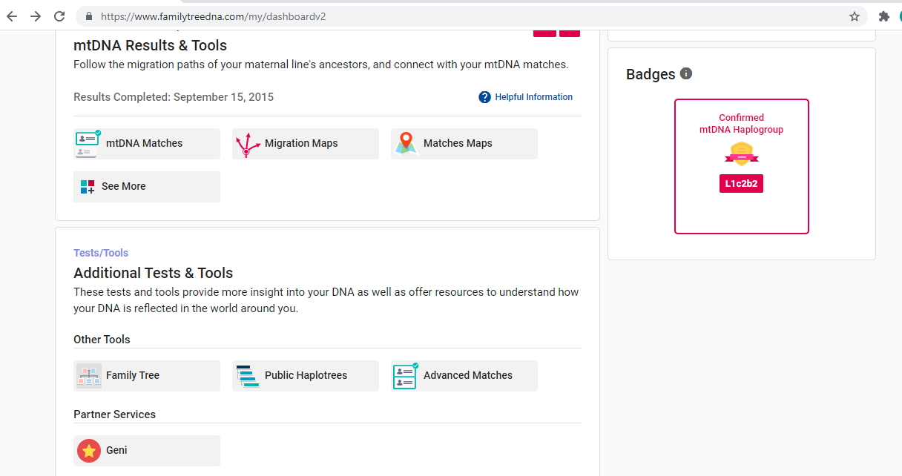

Slide 17
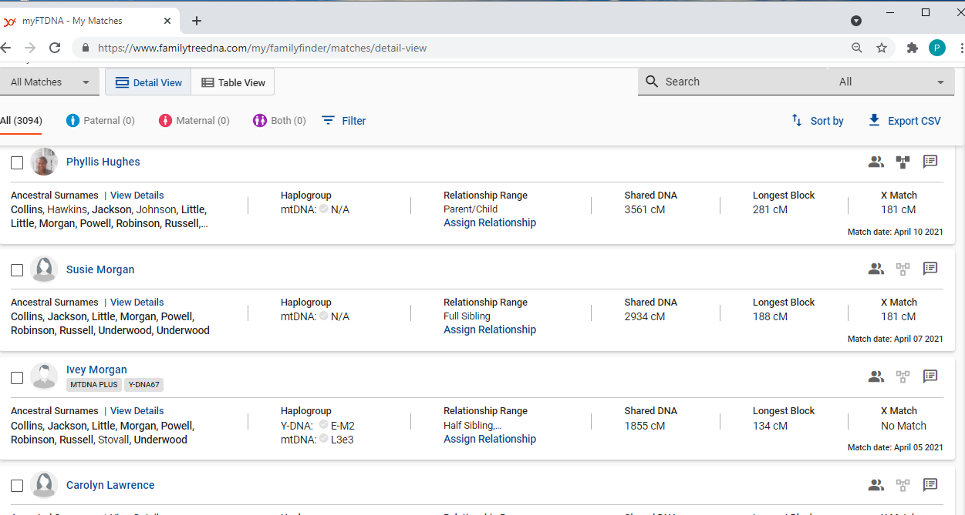

Slide 18
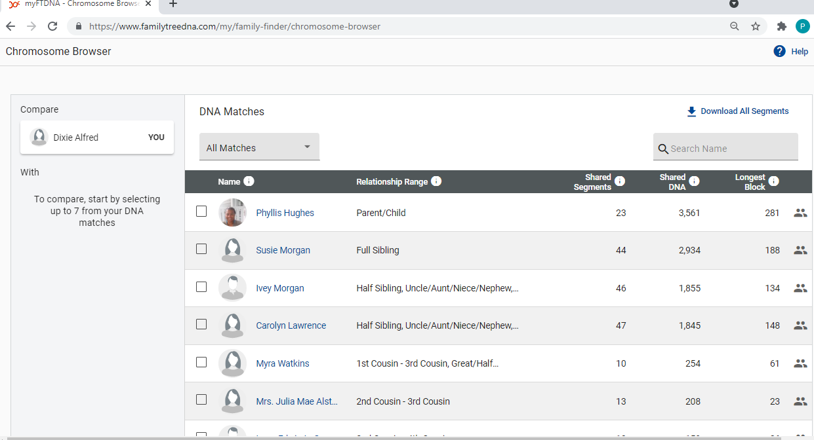

Slide 19
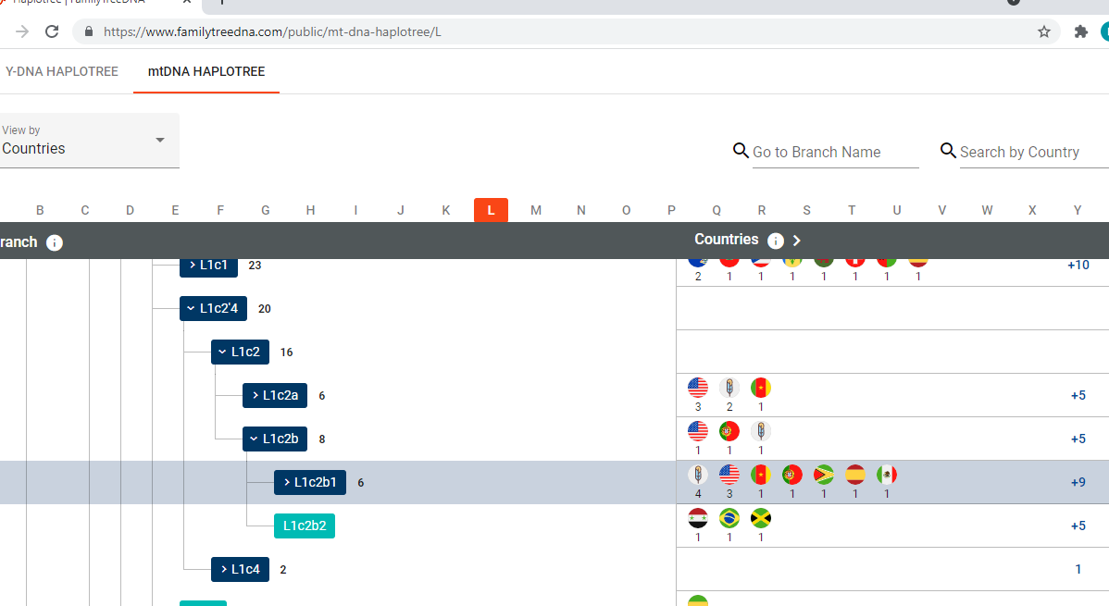

Slide 20
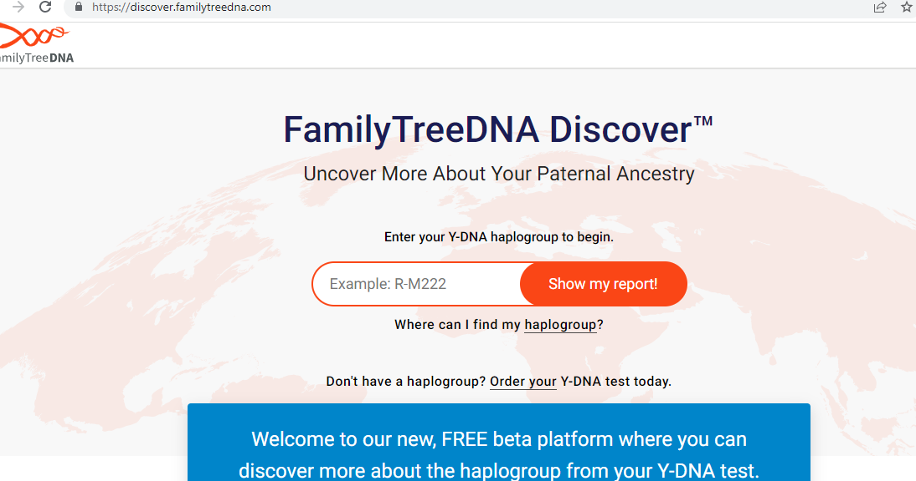

Slide 21
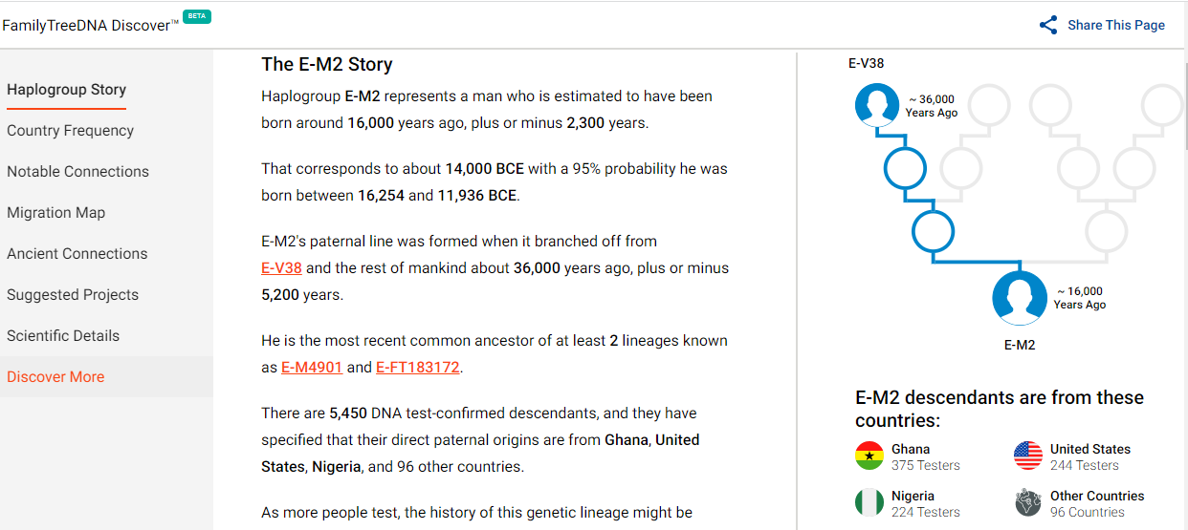

Slide 22
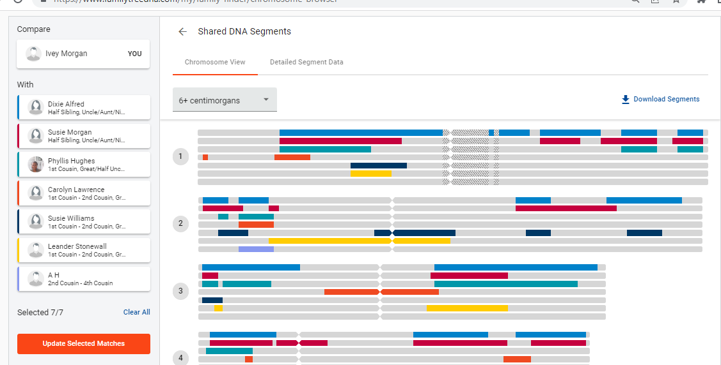

Slide 23
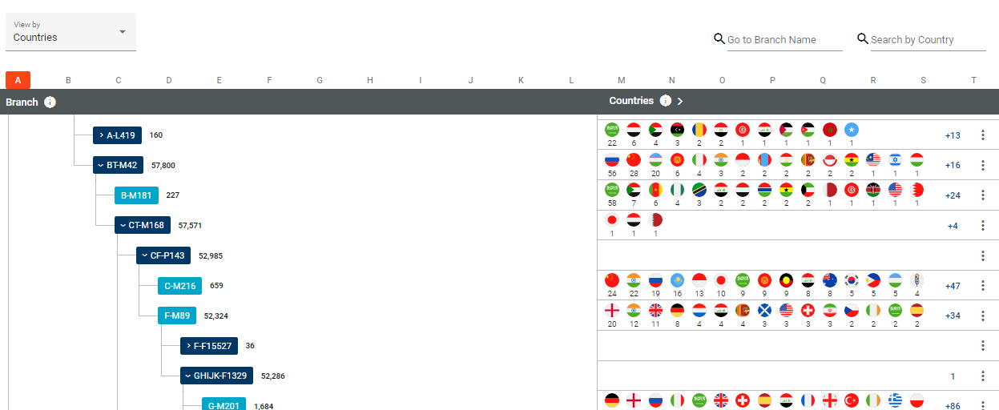

Slide 24
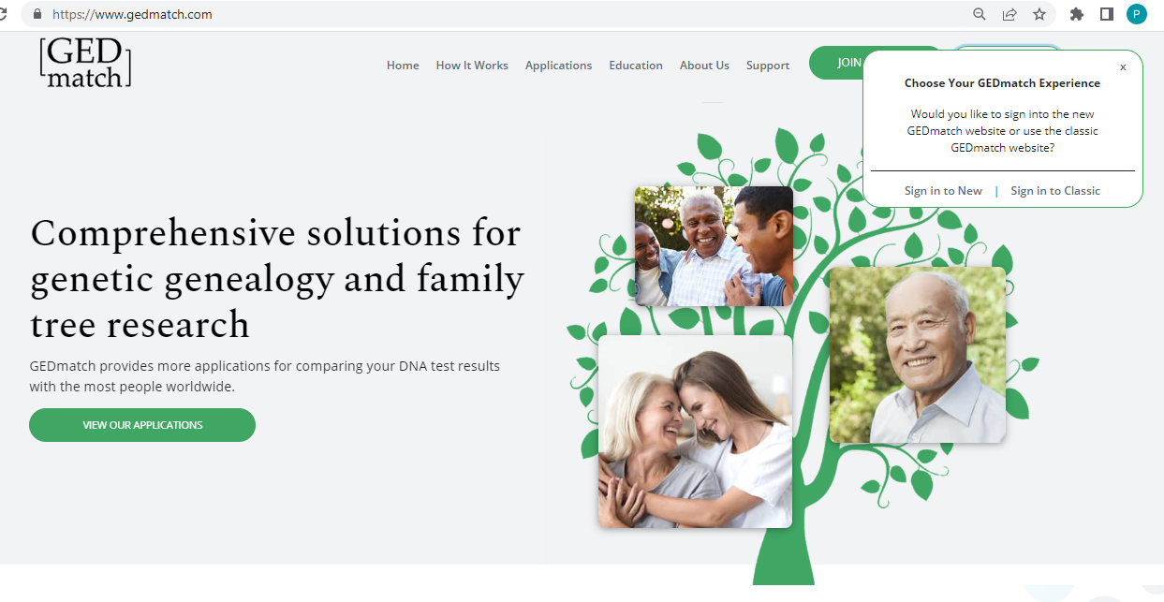

Slide 25
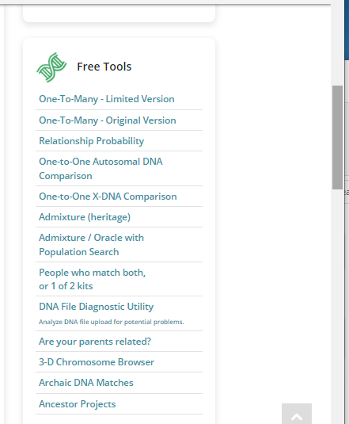

Slide 26
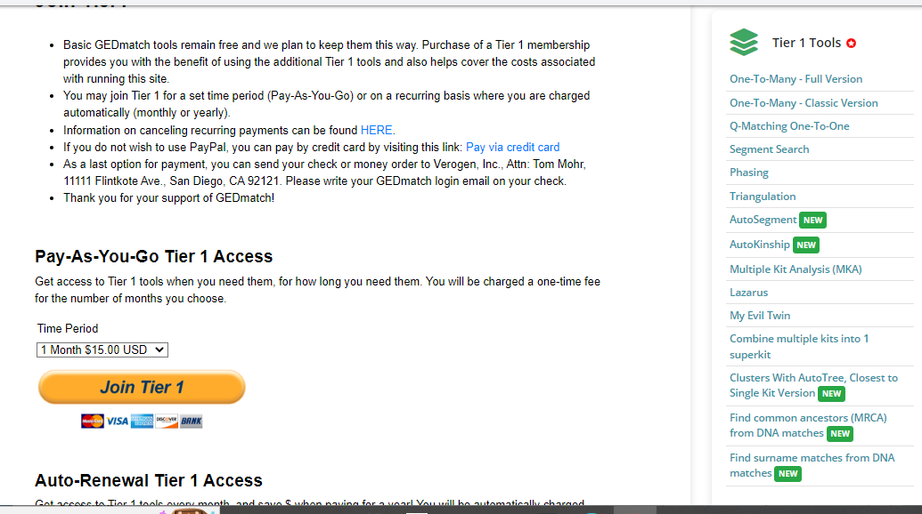

Slide 27
Ancestry: ThruLines
Bob Dahlin

